Slide 1
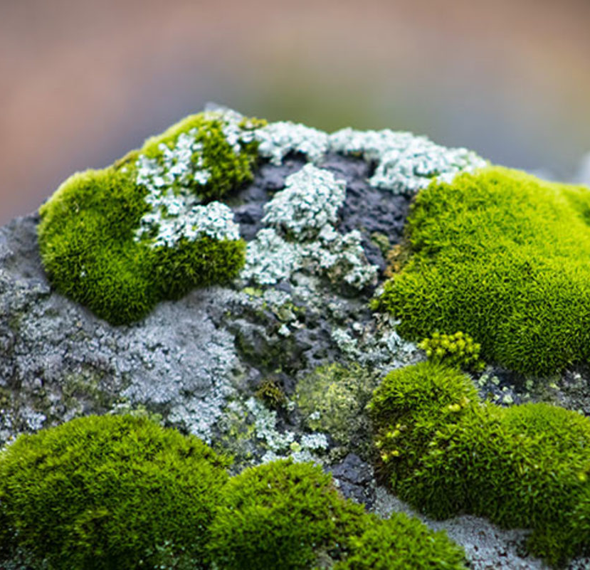
Moss Modeling
By: Benjamin Laubach, Sanskriti Verma, Carrie Nielsen, Jason Williams, Tori Fallon, and Ella Kovach.
Notes:
Ella

Slide 2
Agenda
Objectives
Methods
Baseline Model
Model Analysis
Conclusions
Questions
Notes:
Ella

Slide 3
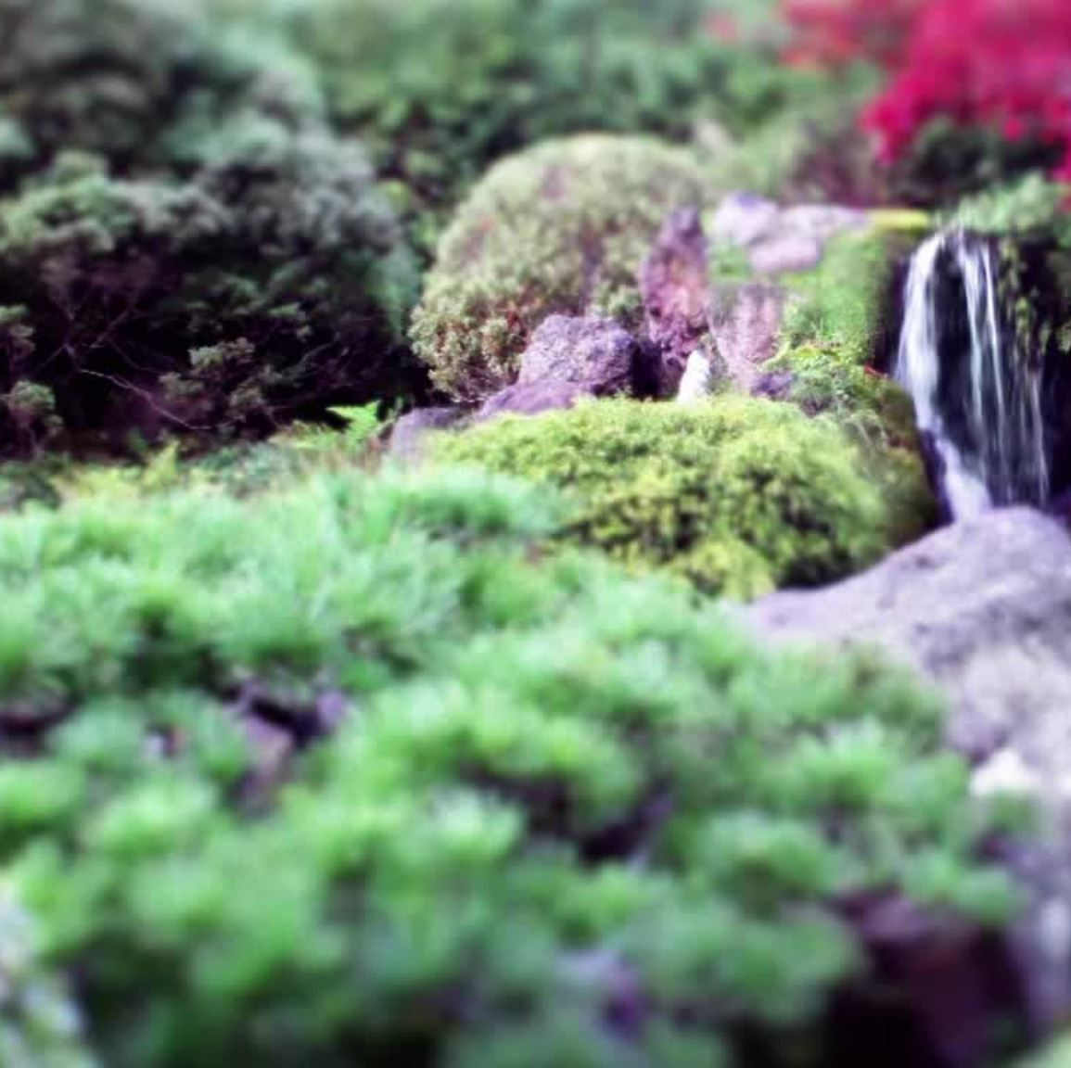
Objective
Observe how moss competes with other organisms and obstacles within its environment.
Observe how different initial conditions affect the model.
What makes Moss Mossy?
Notes:
Ella
How do varying factors affect moss growth in an environment?

Slide 4

Methods
Create an Agent Based Model (ABM) that models how moss population is affected by competition in space.
Understand how variables/ competitors/obstacles affect moss growth.
Use HW3 as basis of design:
Predator/Prey ABM
Environment Class
Notes:
Tori

Slide 5
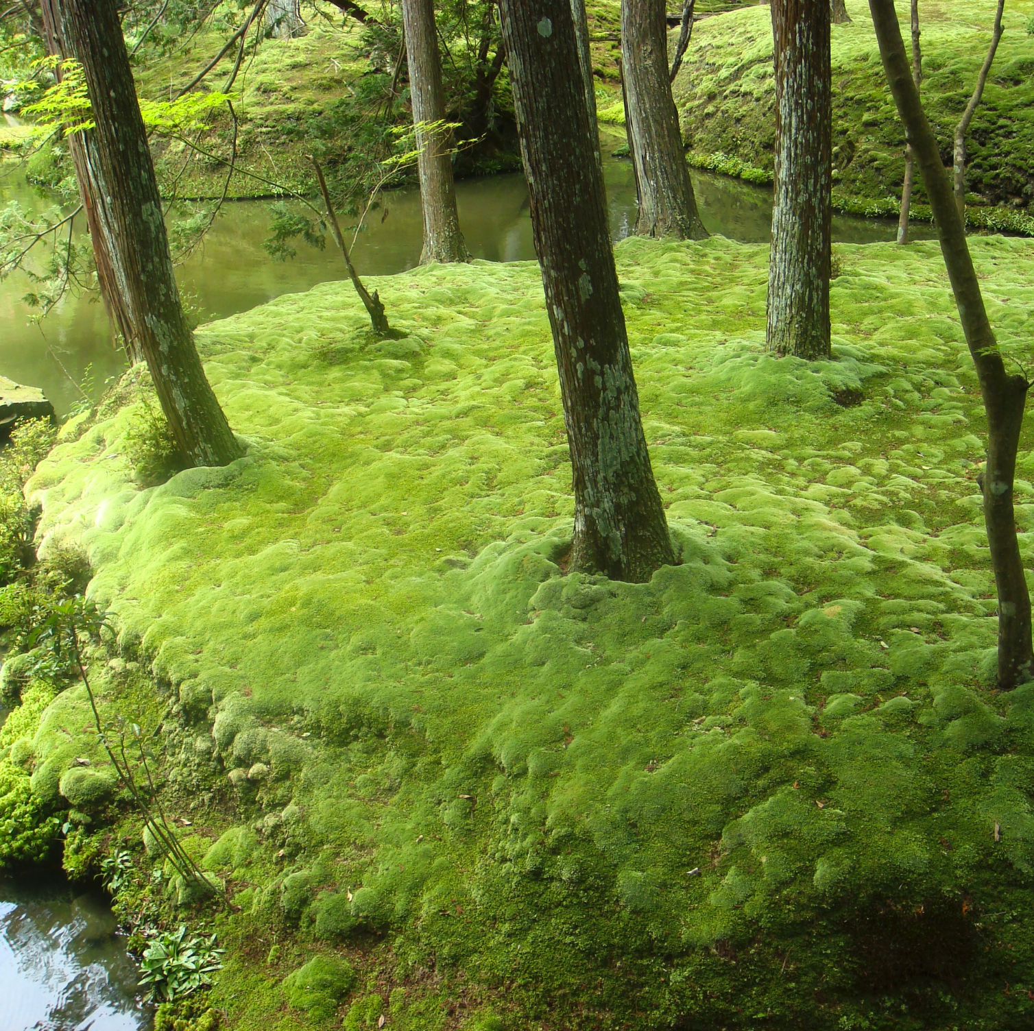
Variables
Fertile land
Agents
Weeds
Moss
Trees
Count
Radius
Land Fertility
Dry land
Normal land
Notes:
Tori

Slide 6
Classes
Moss Agent Class
Position
Growth rate
Grows on:
All land
Weed Agent Class
Inherited from Moss Class
Grows on:
Moss
Fertile land
Normal land
Environment Class
Tree count
Tree radius
Land fertility
Notes:
Connect with homework 3. Sanskriti

Slide 7
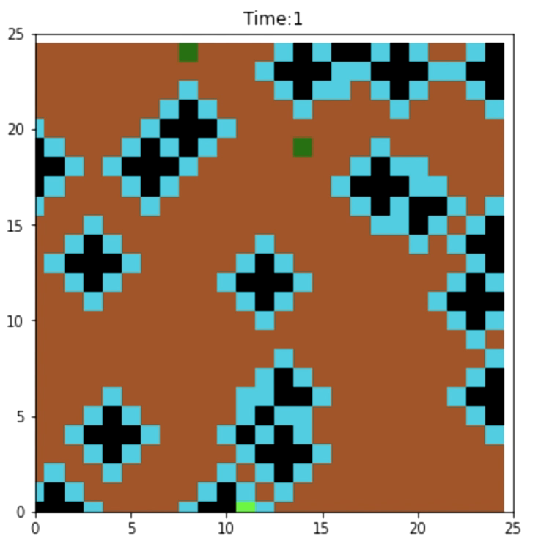
Model in Action
Number of trees = 20
Tree radius = 2
Moss agents = 2
Weed agent = 1
Normal Land
Tree
Dry Land
Weed
Fertile Land
Moss
Notes:
Carrie

Slide 8
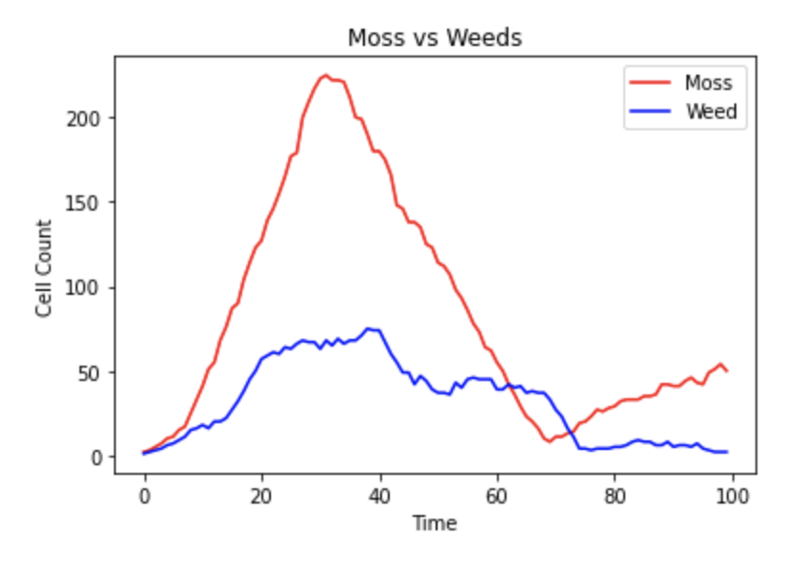
Count of Moss and Weeds
Notes:
Carrie

Slide 9
Model Analysis
Base model assembled with agents and environment characterized
How does tree count influence the moss/weed population?
How does tree radius influence the moss/weed population?
Notes:
Ben

Slide 10
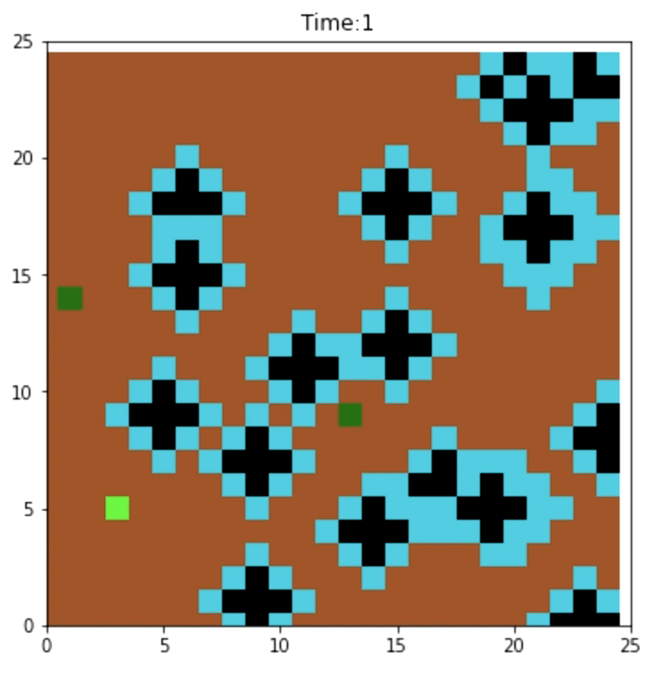
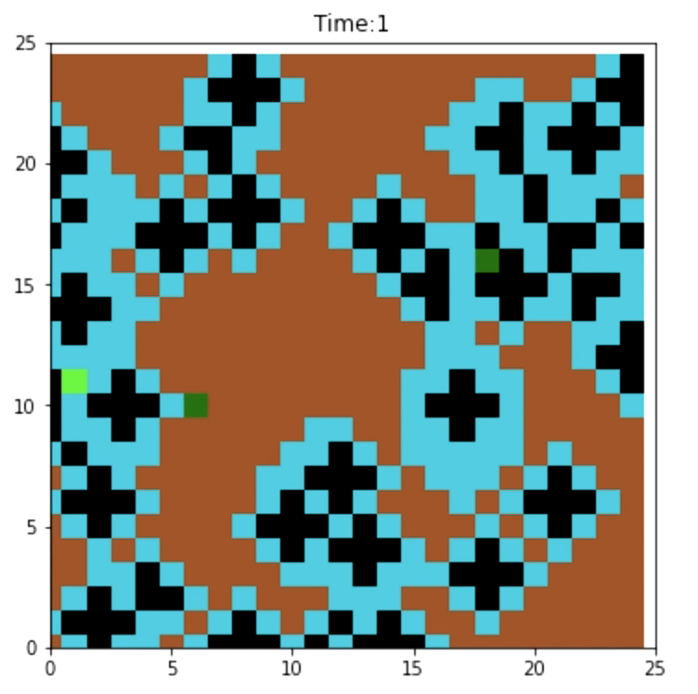
Variation of Tree Count
Number of Trees = 20
Number of Trees = 50
Normal Land
Dry Land
Fertile Land
Tree
Weed
Moss
Notes:
Ben

Slide 11
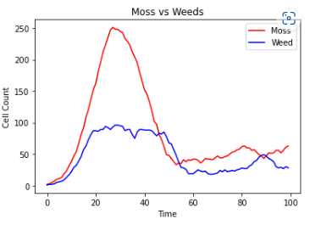
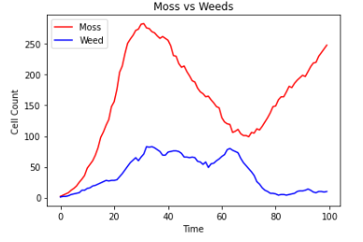
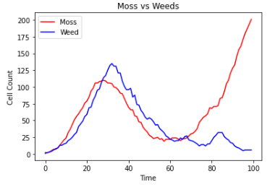
Variation of Tree Count
N = 0
N = 5
N = 10
Notes:
Ben

Slide 12
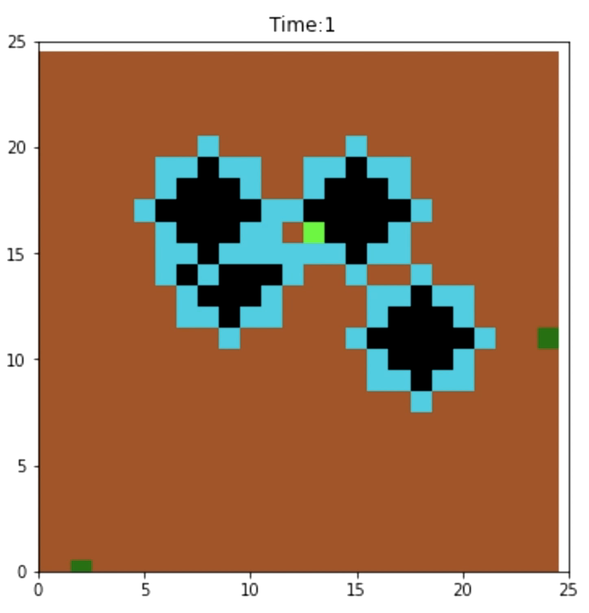
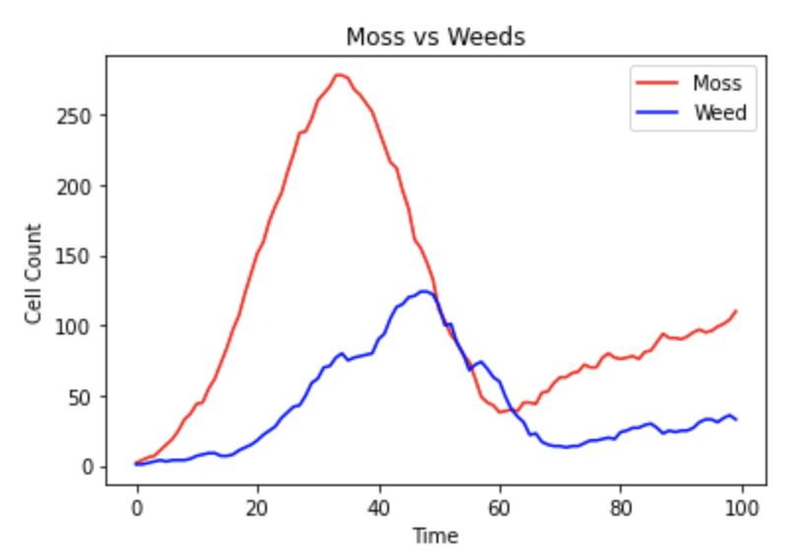
Variation of Tree Radius
Radius = 3
Normal Land
Dry Land
Fertile Land
Tree
Weed
Moss
Notes:
Jason
"Here we have a couple of simulations with different tree radii. We are hoping we see some change if more of the growable environment is taken up by trees. In this one, you can see the moss rapidly grow, and then drop off again. Our graph to the right here shows you the populations over time for this simulation. "

Slide 13
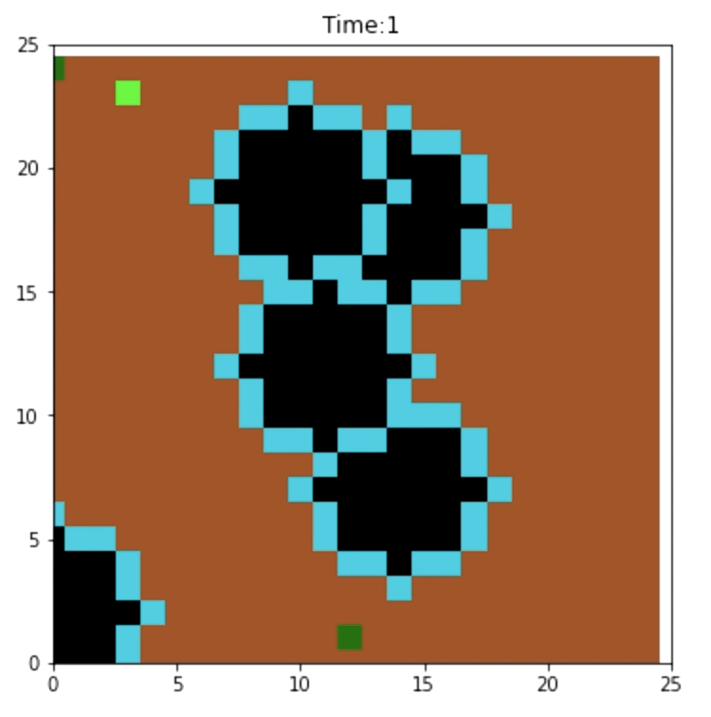
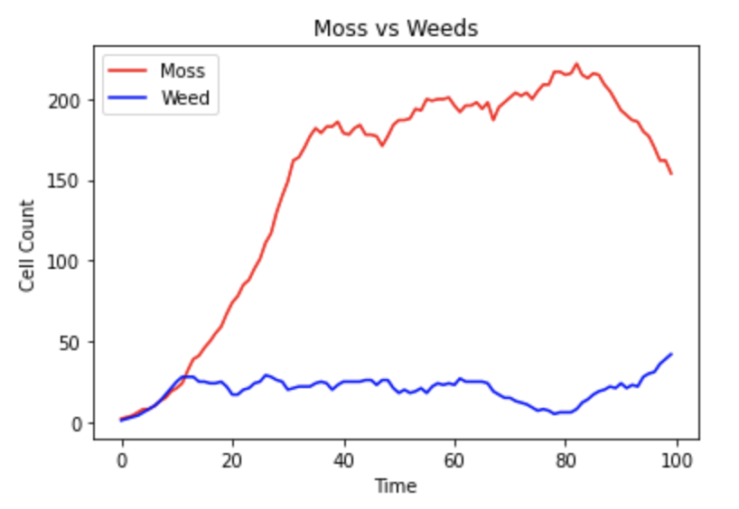
Variation of Tree Radius
Radius = 4
Normal Land
Dry Land
Fertile Land
Tree
Weed
Moss
Notes:
Jason
"In this simulation we have a slightly larger radius, with a much different result. Here we can see the moss rapidly grows and stays at a high population while the numbers of weeds are very low. Now obviously there is some randomness with the simulations, so what kind of results would wee see if we ran it more times?"

Slide 14
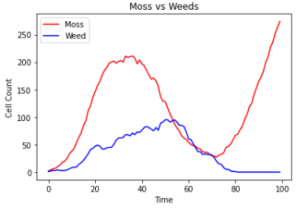
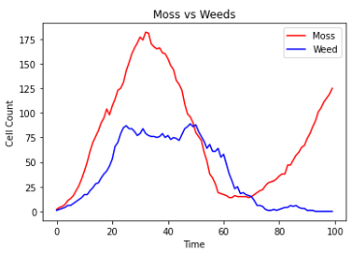
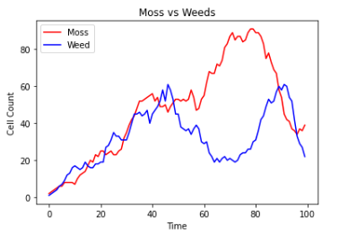
Variation of Tree Radius
N = 5
Radius=1
Radius=3
Radius =5
Notes:
Jason
"Here we can see just that. These are the population graphs from a few other simulations we ran. From this we can see that the NUMBER of moss decreases as the radii increase, while the ratio between the moss and weeds can fluctuate over time. This periodic growth in the moss is another neat observation we weren't expecting, and was seen in a majority of our testing simulations, unless all the moss died of course. "

Slide 15
Conclusion
Overtime Weeds become dependent on Moss.
Tree Count: Increased tree count led to increased moss growth over time.
Tree Radius: Increased tree radius led to decreased moss growth over time.
Initial position has significant impact on growth over time.
Variation among model results even with the same initial conditions.
Notes:
Ella
Once initial environmental resources are depleted, weeds are dependent on moss for life.
Poor position = poor ability to grow

Slide 16

Questions?
Notes:
Ella

